Slide 1
Art 108 Painting 2 Portfolio
Judith Chambers
samantha92114@hotmail.com
Fall 2016

Slide 2
“Bubbles”
Organic painting Oil

Slide 3
“The Wall”
Acrylic painting with sculpture.

Slide 4
“Pigeon”
Acrylic, Geometry painting, complementary colors.

Slide 5
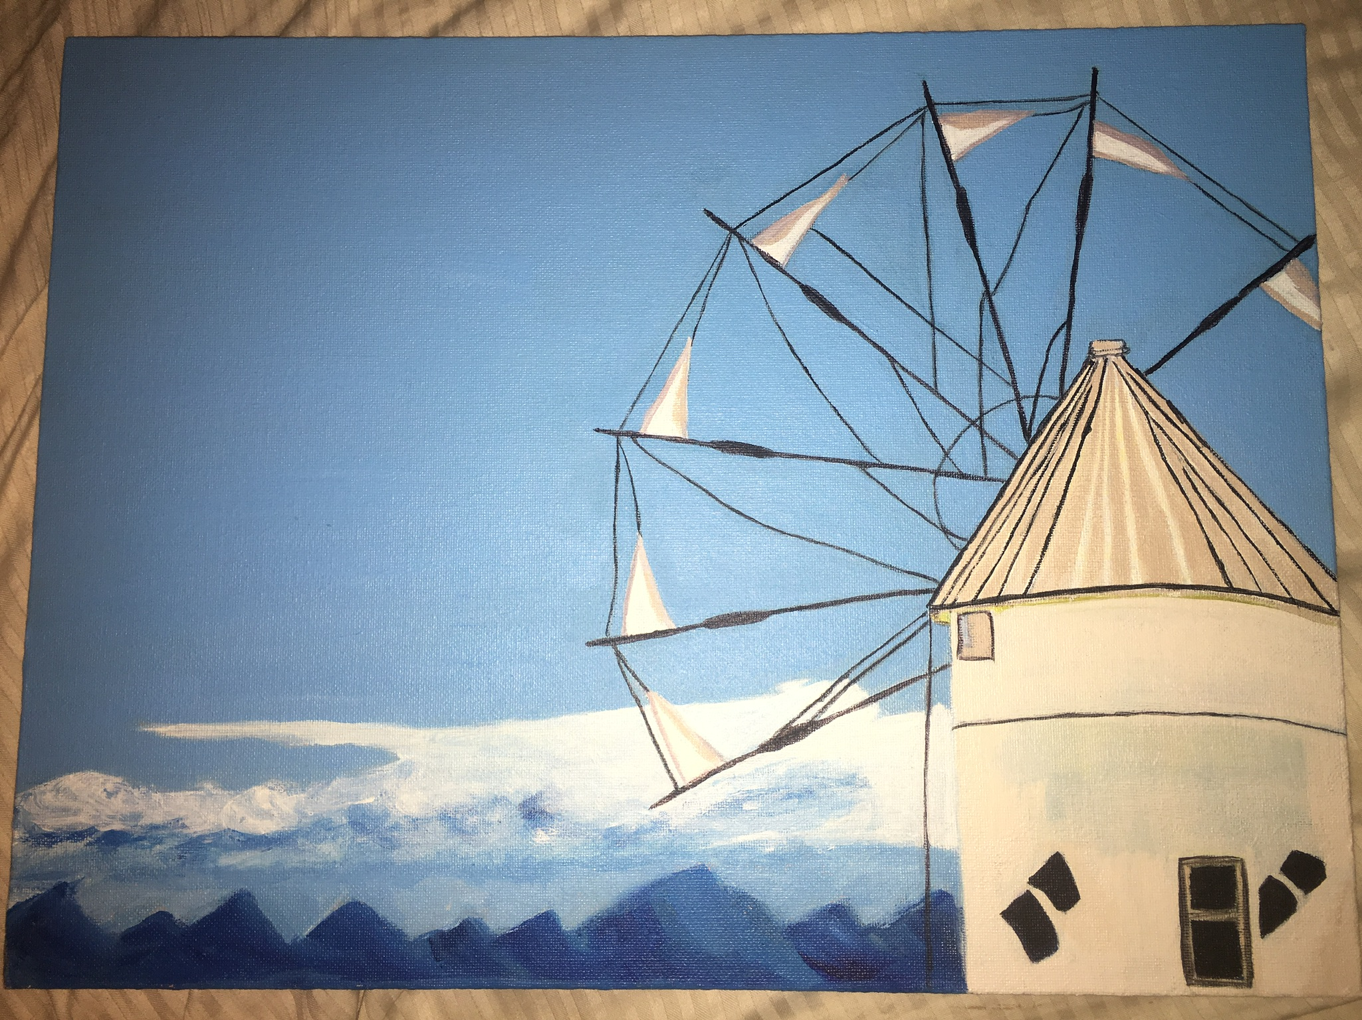
“Windmill”
Acrylic, monochromatic painting.

Slide 6
“Bob Ross Landscape”
Acrylic painting

Slide 7
“Flaming Hot Cheetos”
Acrylic pop culture painting

Slide 8
“Dragon”
Oil, Zedist painting

Slide 9
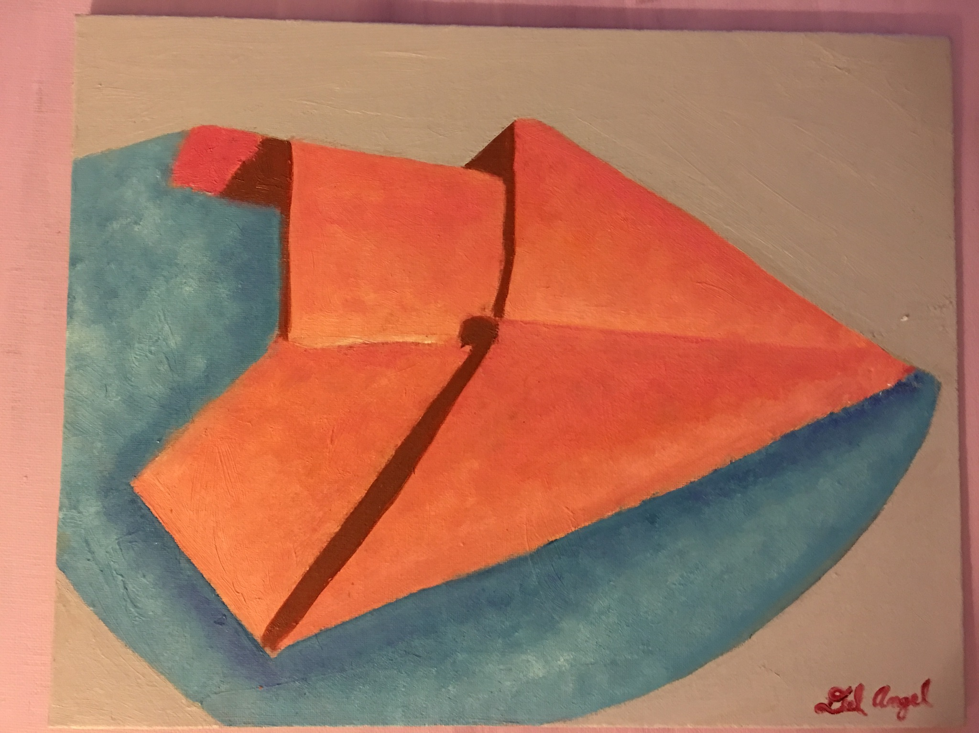
“Paper plane”
Oil, warm and cool colors

Slide 10
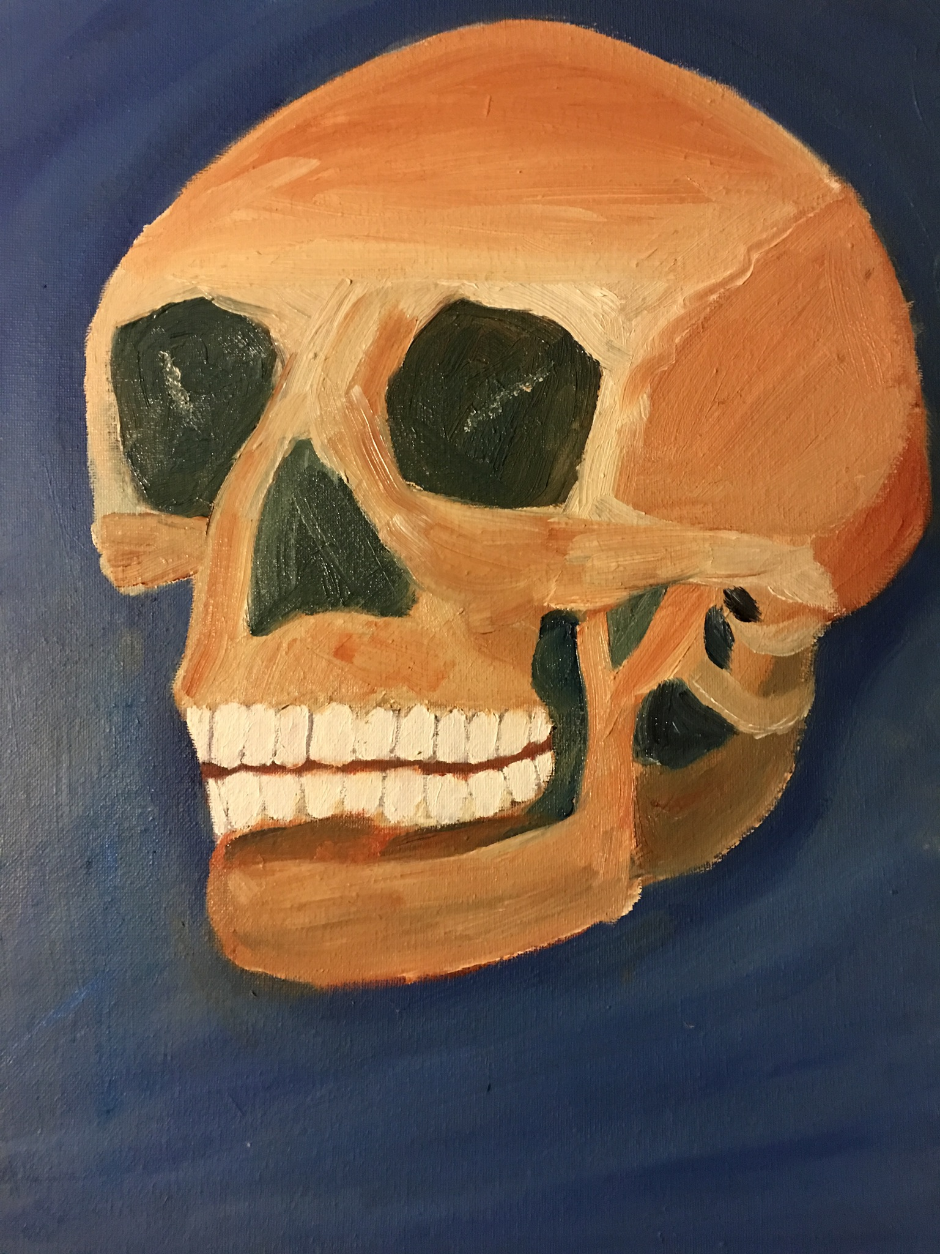
“Dhali’s Skull”
Oil, Chiaroscuro painting.

Slide 11
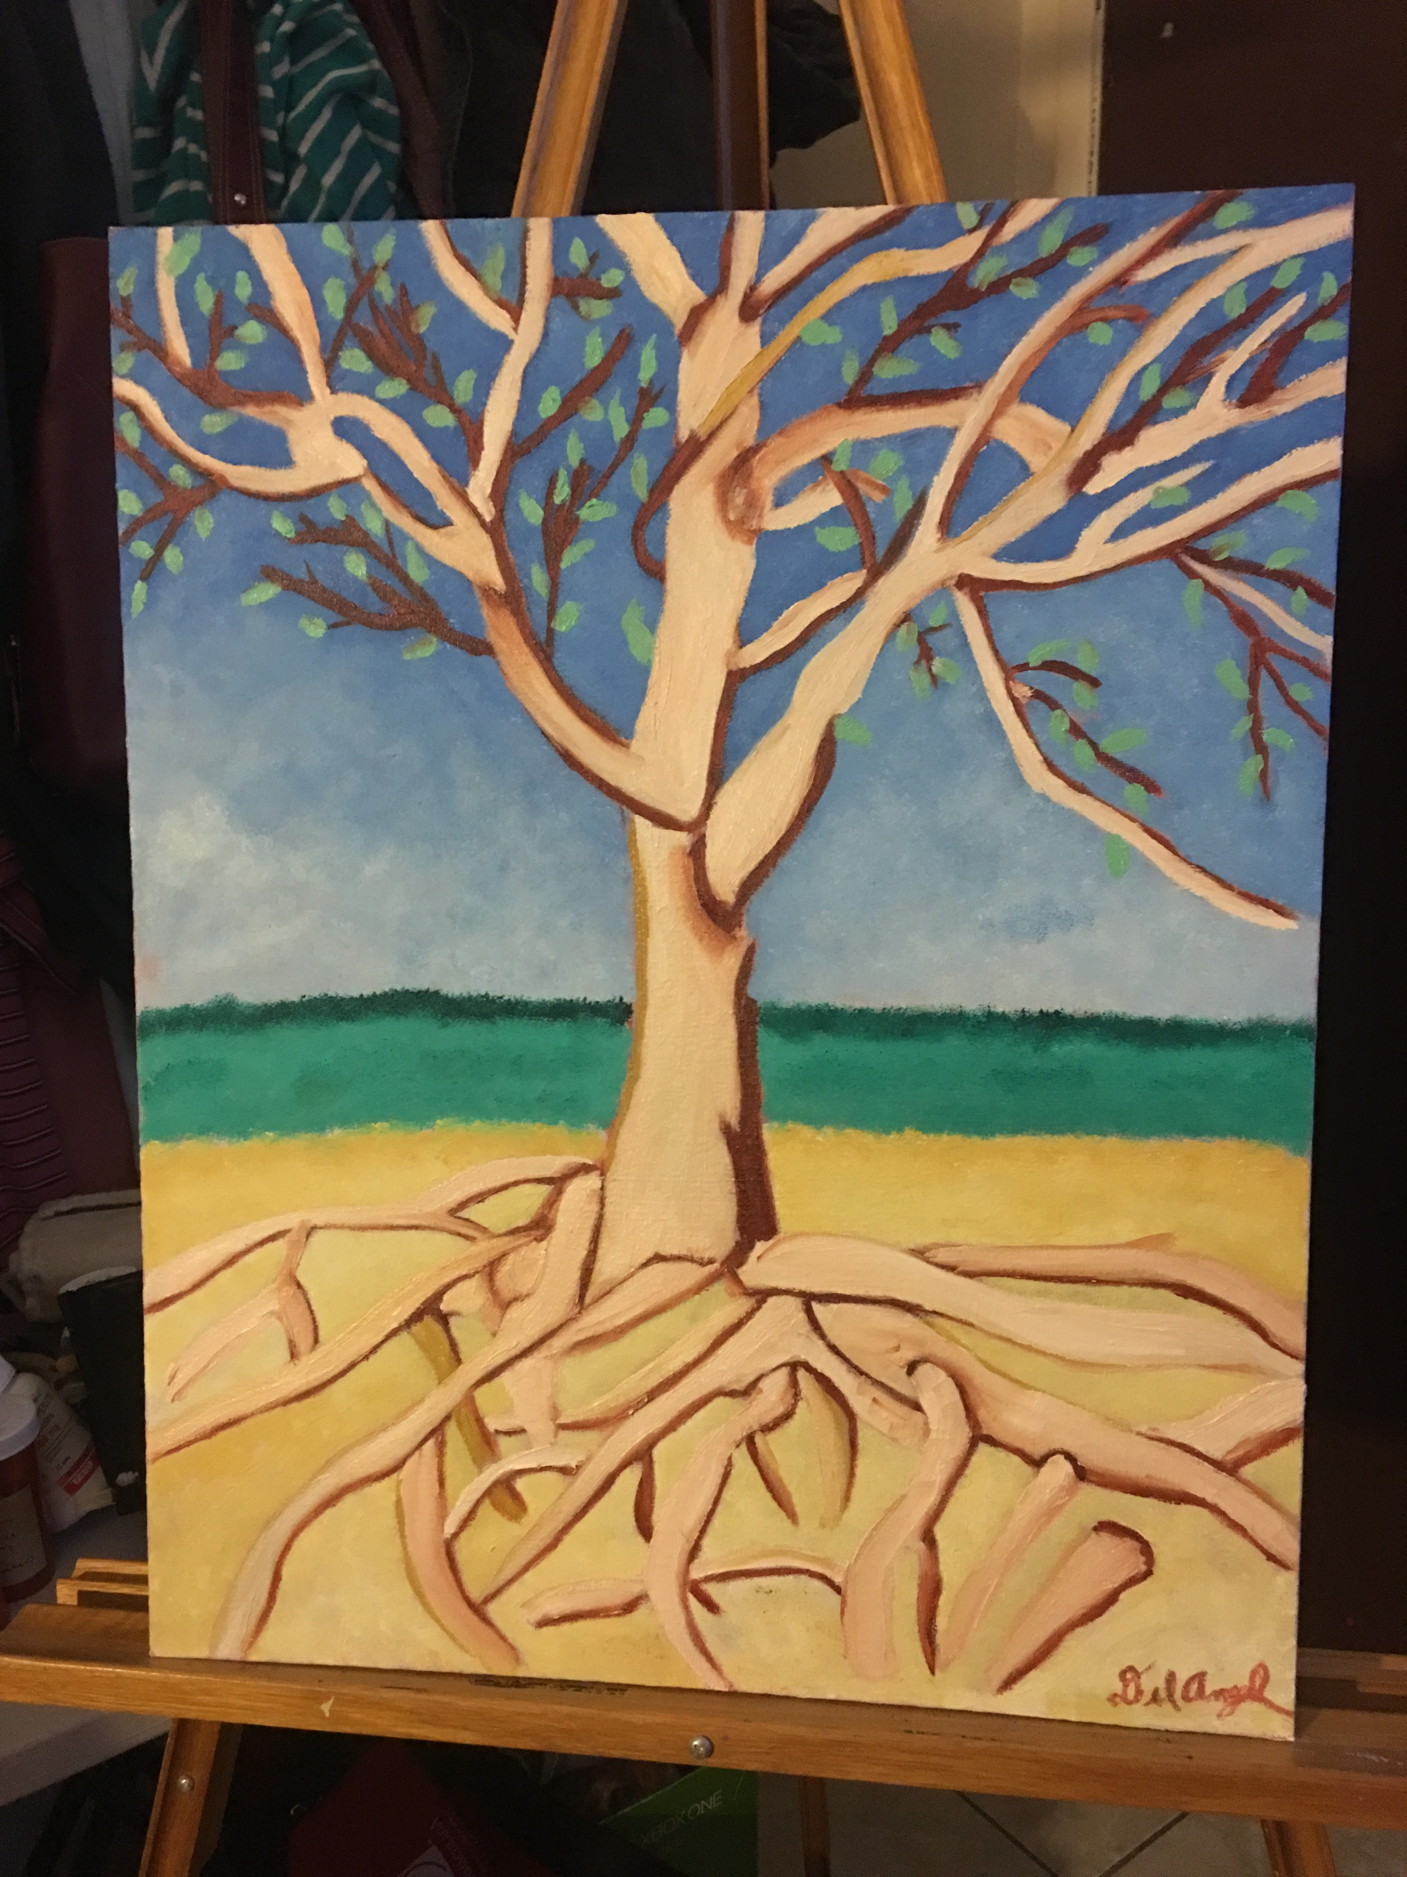
“Adriana’s Tree”
Oil painting.

Slide 12
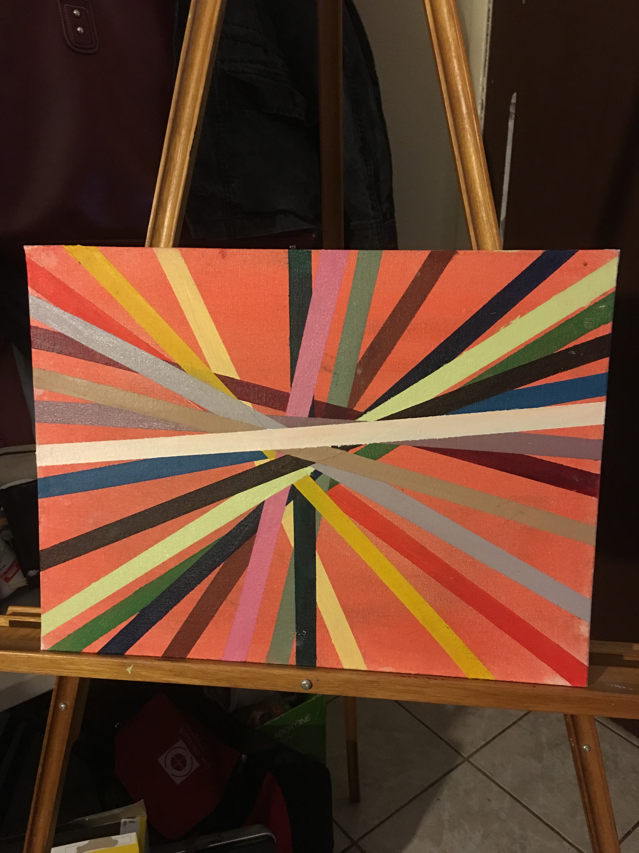
“Refugees”
Oil, working progress

Slide 13
Artist Statement
When I started this class I wanted to learn as much as possible from professor Perry. I wanted to grasp as many painting technics as possible before the semester was over. I was not disappointed. I learned a lot in professor’s Perry class. He is a very patient artist. I was also greatly surprised by the comradery we developed in class. At the end there were a few of us left. You can say that when the semester was over, and it was time to go home, we didn’t want to leave.
I will never forget everything I learned with professor Perry. I am a better artist because I took this class with him. I wish there was Painting 109 so I could take it and learn more from this great artist. I look forward to being his student in the near future, and I look forward to keeping in touch with all the kindred spirits we met in this class.
Thank you for everything professor.

