Slide 1
Wayne Thiebaud
Illusion of volume through color contrast
Breaking down color into shapes

Slide 2
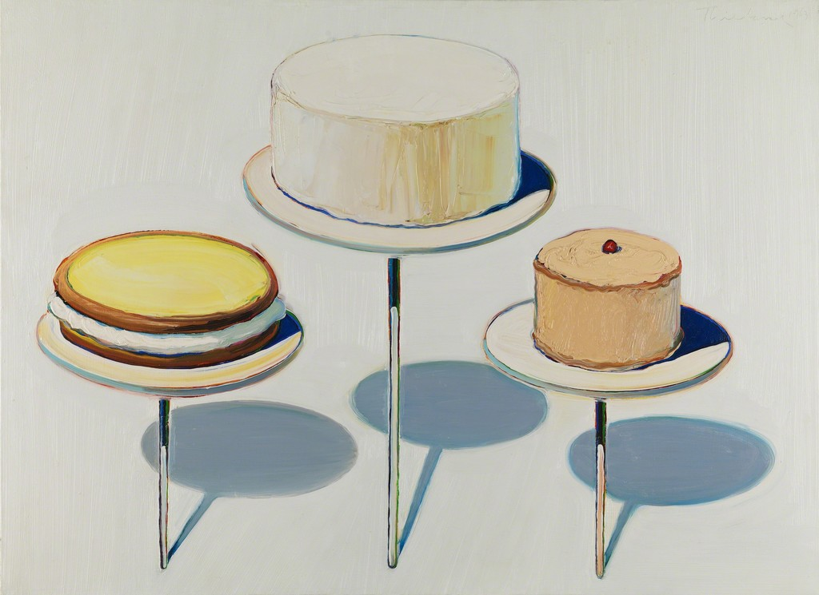
Wayne Thiebaud
Display Cakes, 1963
Oil on canvas
28 × 38 in

Slide 3
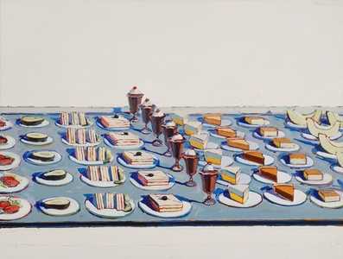
Wayne Thiebaud
Salads, Sandwiches, and Desserts, 1962
Oil on canvas
57 1/2 × 74 1/2 in

Slide 4
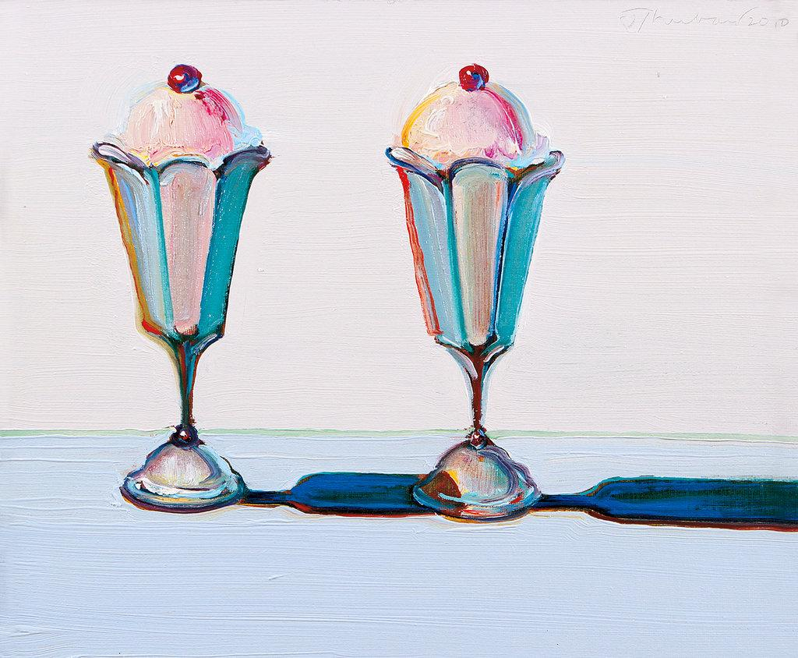
Wayne Thiebaud
“Tulip Sundaes”f
2010.

Slide 5
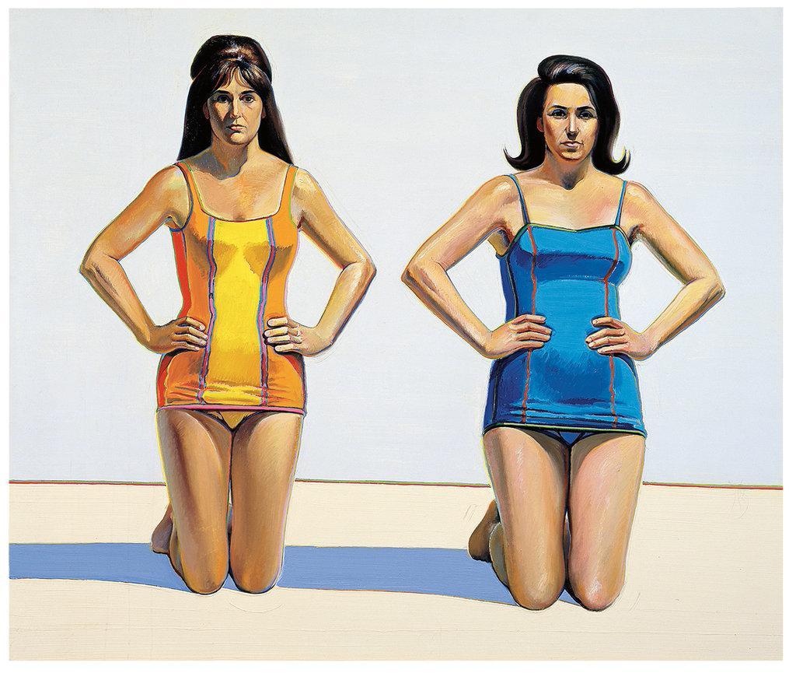
Wayne Thiebaud
“Two Kneeling Figures”
(1966),

Slide 6
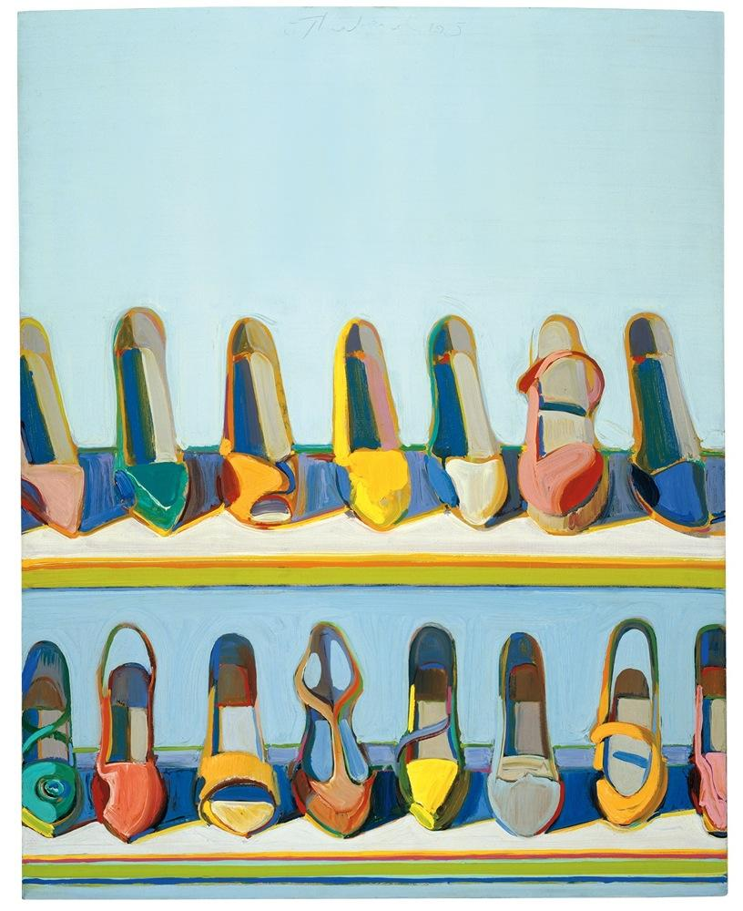
Wayne Thiebaud
“Shoes
(1966),

Slide 7
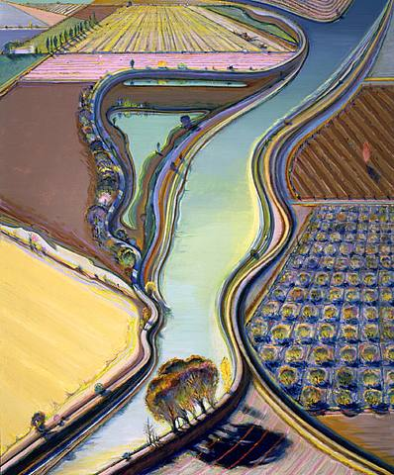
Wayne Thiebaud
“Landscape”
(1990),

